Slide 1
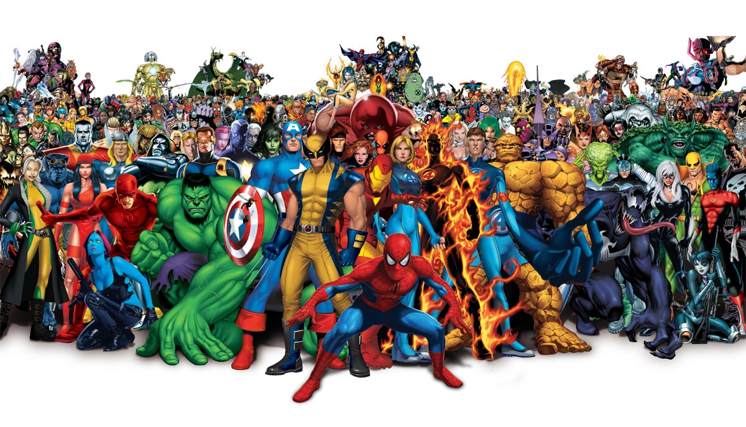
Marvel Universe Social Network
Helen, Alex, Dennis

Slide 2
Dataset
The dataset contains heroes and comics, and the relationship between them. The dataset is divided into three files:
nodes.csv: Contains two columns (node, type), indicating the name and the type (comic, hero) of the nodes. 19,090 rows × 2 columns
edges.csv: Contains two columns (hero, comic), indicating in which comics the heroes appear. 96,104 rows × 2 columns
hero-edge.csv: Contains the network of heroes which appear together in the comics. 574467 rows × 2 columns
https://www.kaggle.com/csanhueza/the-marvel-universe-social-network/code

Slide 3
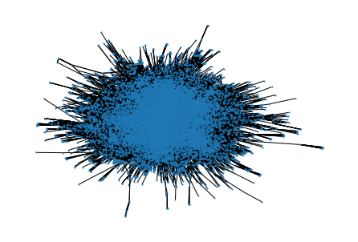
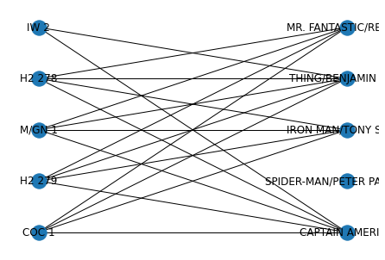
Bipartite Graphs
Example with 5 highest heroes and comics
# Nodes: 19,090
# Edges: 96,104

Slide 4
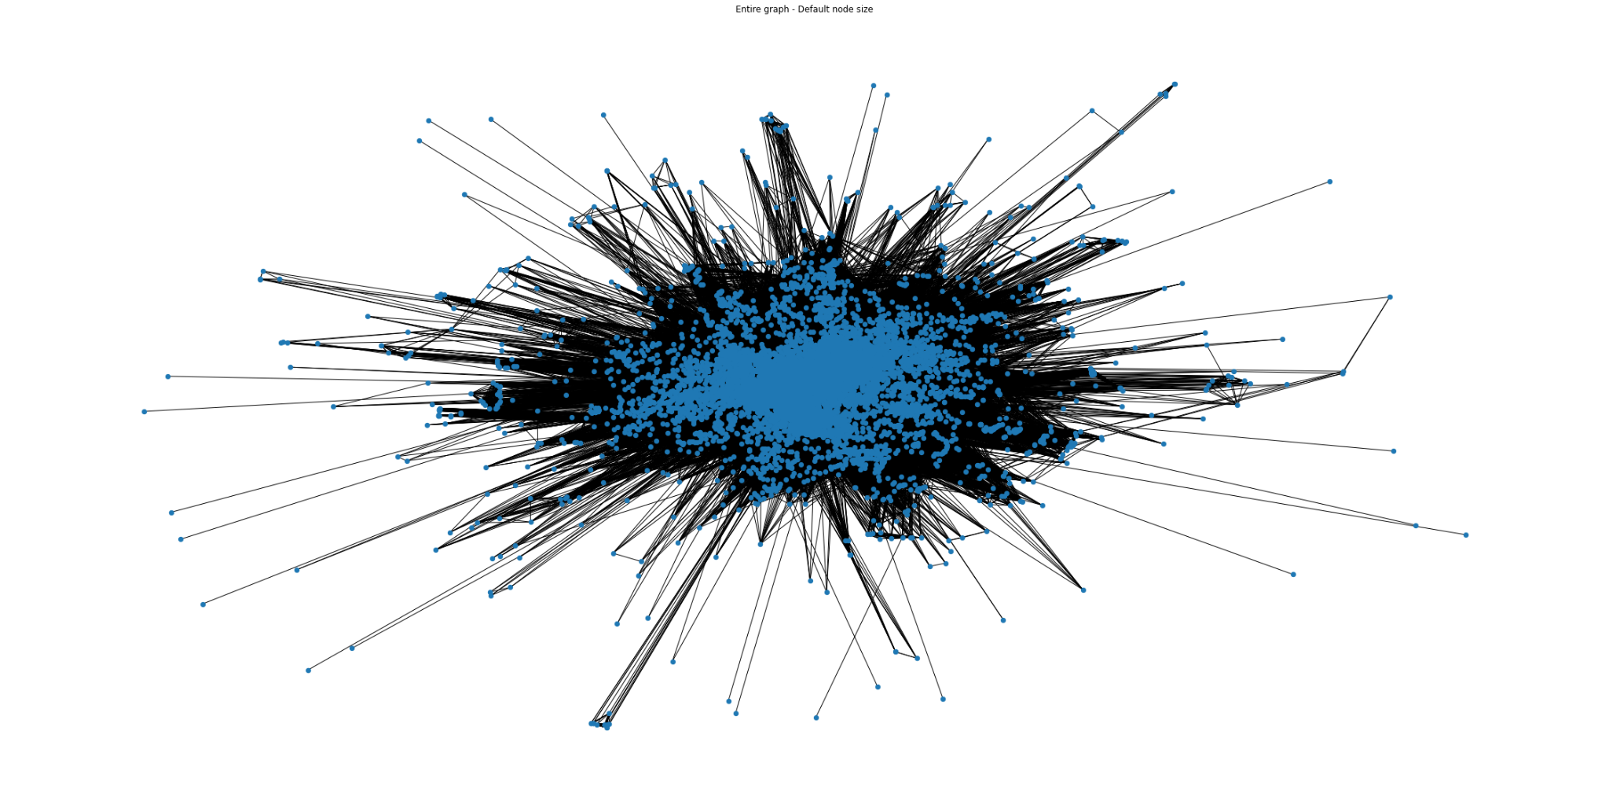
Unipartite Graphs: Comics
# Nodes: 12,626
# Edges: 11,976,774

Slide 5
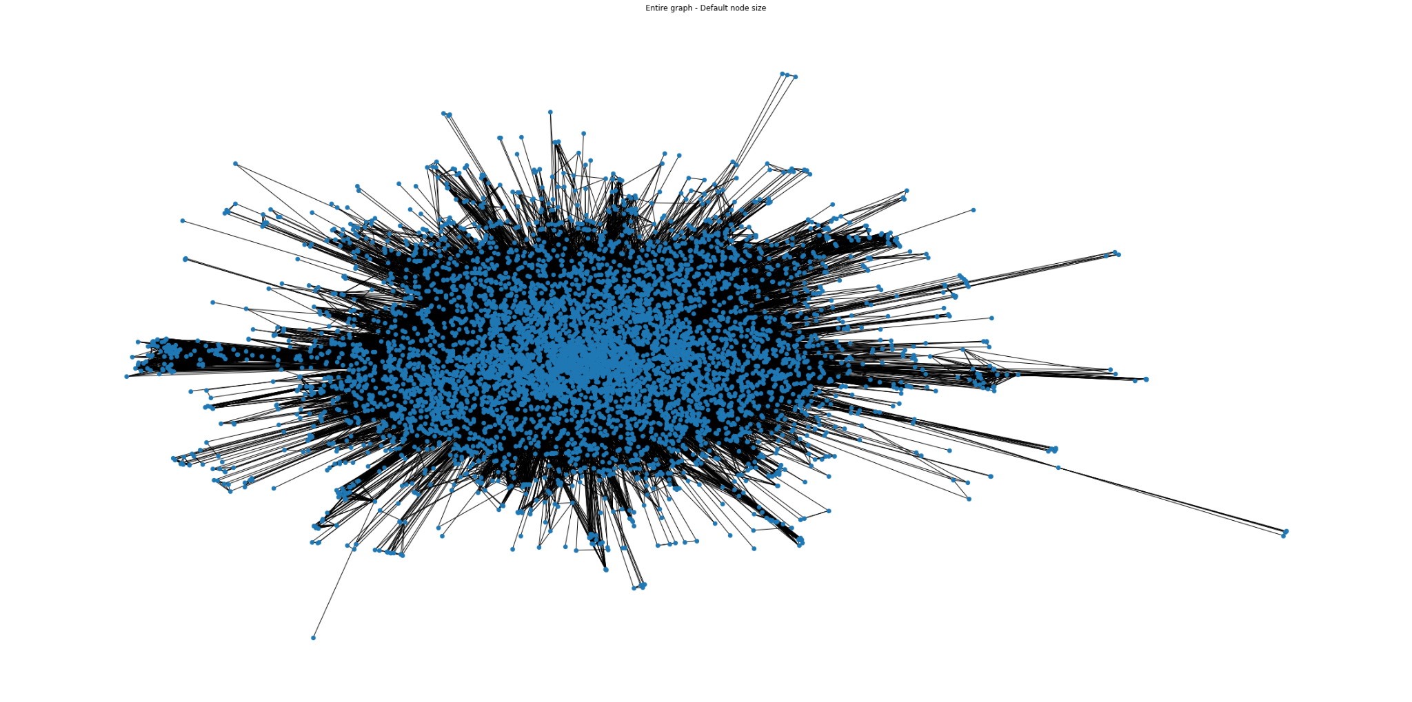
Unipartite Graphs: Heroes
# Nodes: 6,403
# Edges: 579,100

Slide 6
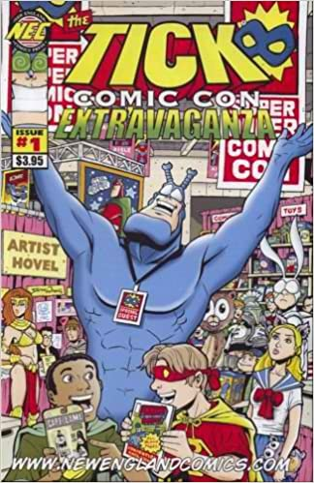
COMICS: Most connected Comics, Distribution of degrees
TOP 5 COMICS:
['COC 1',
'H2 279',
'M/GN 1',
'H2 278',
'IW 2']
TOP 5 COMICS DEGREES:
[9665,
9241,
8756,
8485,
8278]

Slide 7
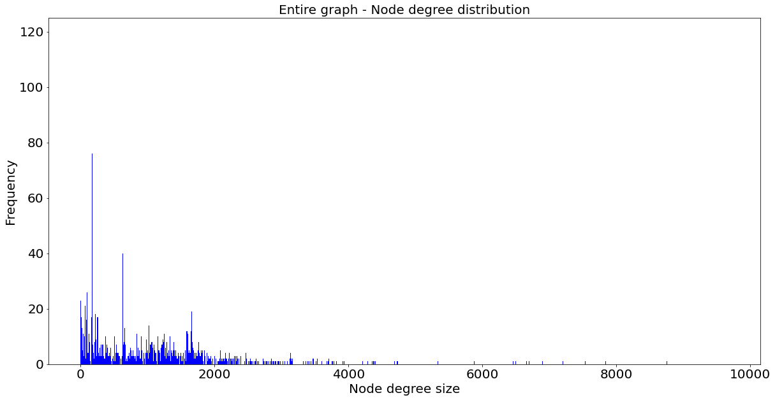
COMICS: Most connected Comics, Distribution of degrees
It is Scale Free!

Slide 8
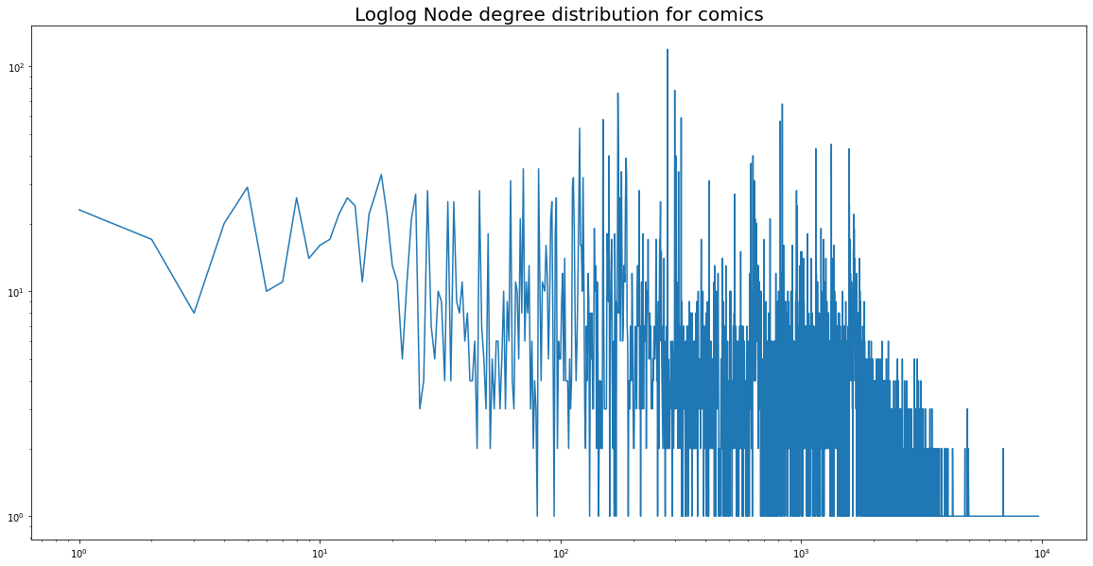
Actually it is not Scale Free!

Slide 9
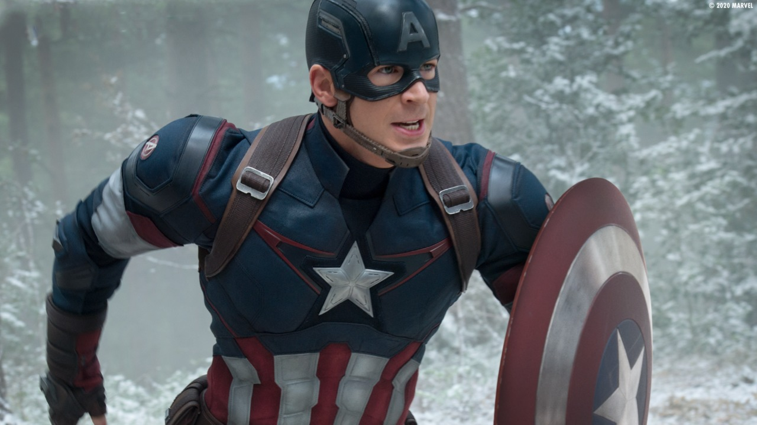
HEROES: Most connected Heroes, Distribution of degrees
TOP 5 HEROS:
['CAPTAIN AMERICA',
'SPIDER-MAN/PETER PARKER',
'IRON MAN/TONY STARK',
'THING/BENJAMIN J. GR',
'MR. FANTASTIC/REED R']
TOP 5 HEROS DEGREES:
[1919,
1754,
1566,
1448,
1416]

Slide 10
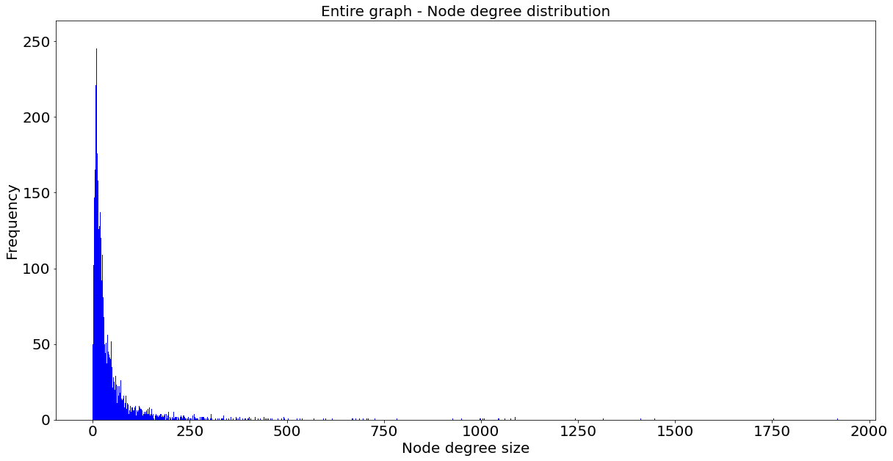
HEROES: Most connected Heroes, Distribution of degrees
It is Scale Free!

Slide 11
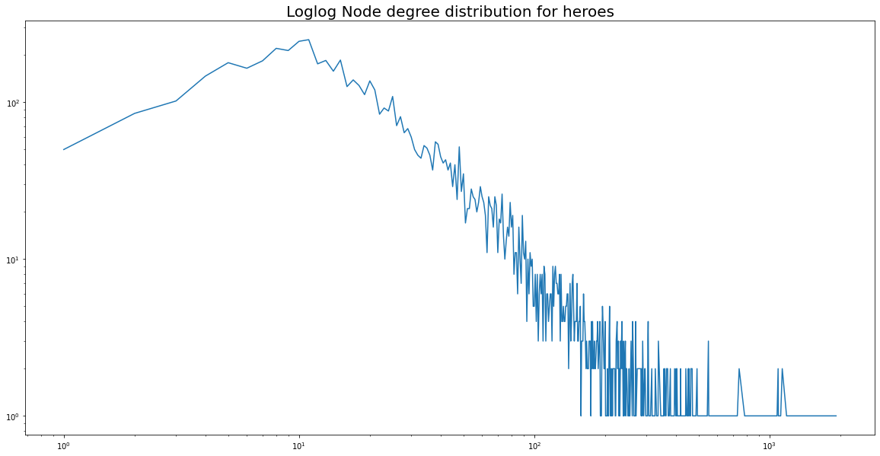
Actually it is not Scale Free, but it is more scale free than heroes!

Slide 12
Centralities for Comics
Degree centrality | Closeness centrality | Eigenvector centrality | Betweeness centrality
COC 1 (0.765) | COC 1 (0.809) | H2 279 (0.038)
H2 279 (0.731) | H2 279 (0.788) | COC 1 (0.038)
M/GN 1 (0.693) | M/GN 1 (0.764) | M/GN 1 (0.038)
H2 278 (0.672) | H2 278 (0.752) | H2 278 (0.037)
IW 2 (0.655) | IW 2 (0.743) | M/TIO 96 (0.037)

Slide 13
Centralities for Heroes
Degree centrality | Closeness centrality | Eigenvector centrality | Betweenness centrality
CAPTAIN AMERICA (0.299) | CAPTAIN AMERICA (0.586) | CAPTAIN AMERICA (0.114)
SPIDER-MAN/PETER PARKER (0.273) | SPIDER-MAN/PETER PARKER (0.586) | IRON MAN/TONY STARK (0.101)
IRON MAN/TONY STARK (0.244) | IRON MAN/TONY STARK (0.565) | THING/BENJAMIN J. GR (0.100)
THING/BENJAMIN J. GR (0.226) | THING/BENJAMIN J. GR (0.561) | SCARLET WITCH/WANDA' (0.099)
MR. FANTASTIC/REED R (0.221) | MR. FANTASTIC/REED R (0.560) | MR. FANTASTIC/REED R (0.099)

Slide 14
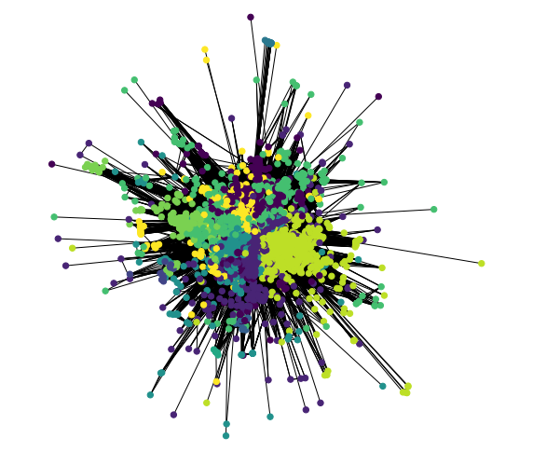
Communities in Comics
The number of communities is 10.

Slide 15
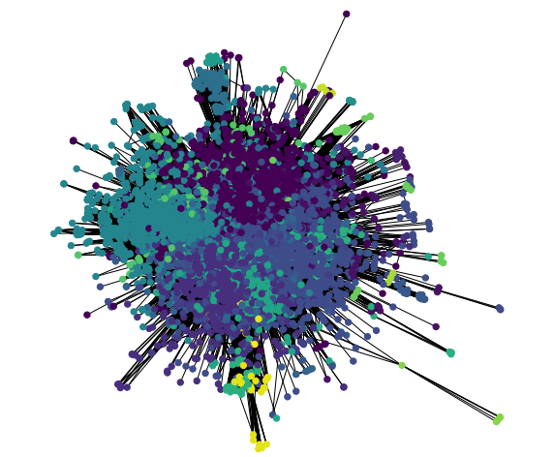
Communities in Heroes
The number of communities is 22.

